Slide 1
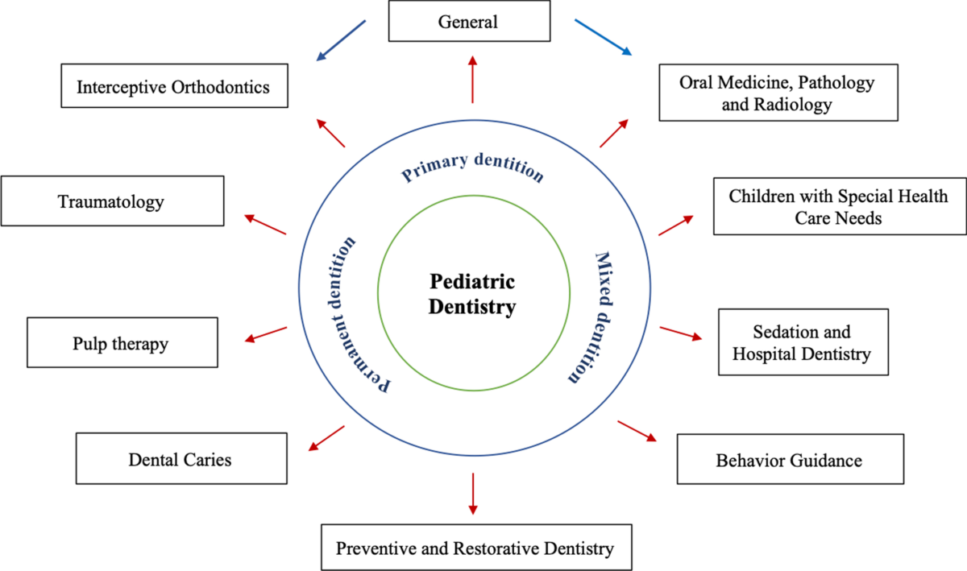
RESEARCH PAPER SUMMARY
International Conference
on Dental Research
Dental Behavior
Management Problems
in Swedish Children
G. Klingberg, L. Vannas Löfqvist, S. Bjarnason, J.G. Norén
University of Göteborg, Sweden
Community Dent. Oral Epidemiol. 22(3):201-205 (1994)
DOI: 10.1111/j.1600-0528.1994.tb01841.x
n = 4,505 children
Ages 4-11 years
Public Dental Service, Göteborg
February 2026

Slide 2
Study Overview & Prevalence
10.5%
Prevalence of BMP
Study Design & Setting
of children exhibited behavior management problems
Cross-sectional epidemiological study conducted in Göteborg, Sweden. Dental charts were systematically retrieved from clinics within the Public Dental Service, ensuring a representative sample from the national healthcare system.
Total Sample Size
4,505 children
Age Range
4-11 years
Study Location
Göteborg, Sweden
Data Collection
Key Prevalence Insight
Comprehensive chart review compiled data on behavior management problems (BMP), actions taken against BMP, caries experience, fillings, use of local anesthetics, and number of missed appointments.
The 10.5% prevalence indicates that approximately 1 in 10 Swedish children experience significant behavioral challenges during dental treatment, representing a substantial clinical concern for pediatric dentistry practice.
Note: This landmark study provides foundational epidemiological data on pediatric dental behavior management in Scandinavia.

Slide 3
Key Findings & Clinical Implications
Age-Related Patterns
Pain Management Link
BMP significantly more common in younger children. The study demonstrates a clear age gradient, with younger children (4-6 years) showing higher rates of disruptive behavior during dental procedures compared to older children (9-11 years).
Higher BMP in children treated without local anesthetics. Restorative treatment without adequate pain control was associated with increased behavior problems, highlighting the critical importance of effective pain management in pediatric dentistry.
Missed Appointments
Oral Health Impact
Strong association between BMP and missed appointments. Children with behavior management problems were significantly more likely to miss scheduled dental visits, suggesting avoidance behavior patterns in response to dental anxiety.
BMP children had worse dental health outcomes. Children with behavior problems exhibited more carious surfaces and fewer filled surfaces compared to cooperative children, indicating that BMP may lead to delayed or incomplete treatment.
Critical Clinical Finding
43.4% of BMP cases resulted in treatment postponement or no action taken. This alarming finding suggests that many dentists lack effective strategies for managing difficult behaviors, potentially leading to deterioration of children's oral health and reinforcing dental avoidance patterns.

